Slide 1
IS MY STATE GOOD ENOUGH FOR MY MENTAL HEALTH?
Data Science and Big Data - Fall 2020
Akshay Oza and Mansi Panchamia

Slide 2
01
METHODOLOGY
AND DATA

Slide 3
Methodology
Problem Formulation and Scoping
Data Extraction and preprocessing
Analysis and Key Findings
Conclusion and Recommendations

Slide 4
Data Sources
Mental Health Data (2011-2018)- Centre for Disease Control
Well Being Index (2015-2018) - Gallup
Mental Health Care Ranking (2015-2018) - Mental Health America

Slide 5
02
ANALYSIS
AND
FINDINGS

Slide 6
Part 1: Bird’s eye view of the United States

Slide 7
8% increase in average number of unhealthy mental days per month from 2011 to 2018 when people felt "down, depressed, or hopeless nearly every day”

Slide 8
Part 2.1: Female Tax in Mental Health

Slide 9
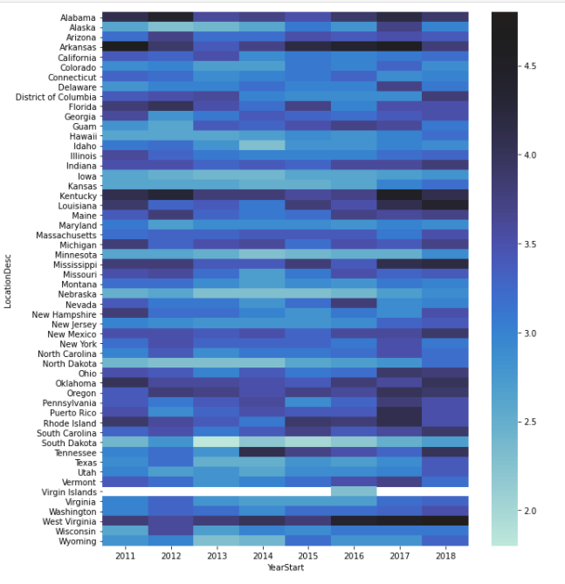
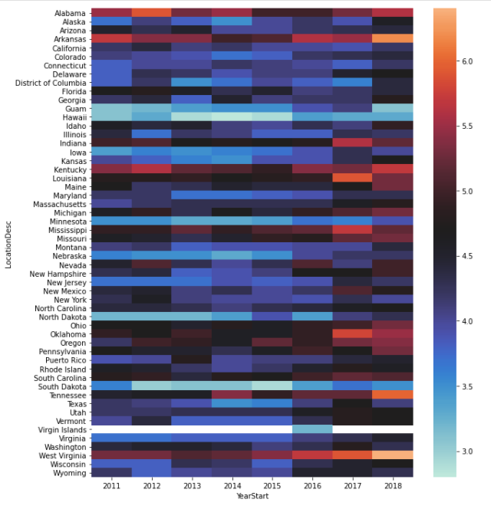
In 2018, females experienced 37% more unhealthy mental days per month than men, up from 30% in 2011

Slide 10
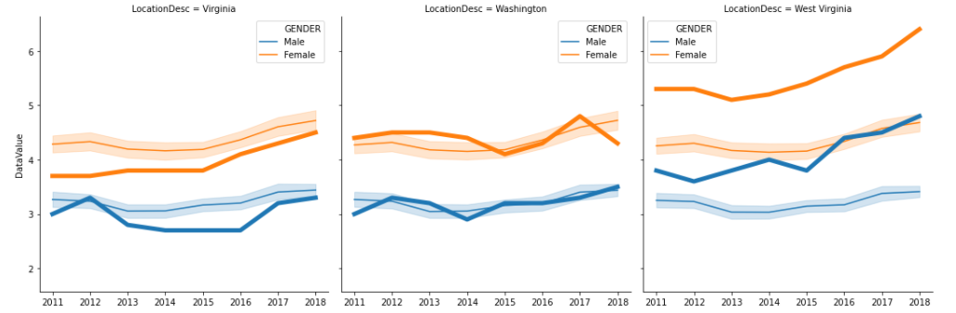
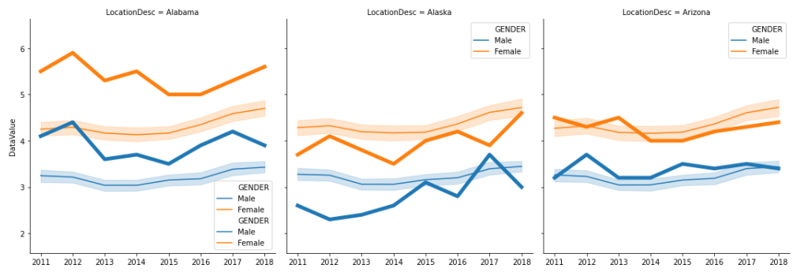
Tennessee, West Virginia have the highest gender gap in average number of unhealthy mental days from 2011-2018. Hawaii and Guam have the lowest

Slide 11
Part 2.2 : Race matters when it comes to Mental Health

Slide 12
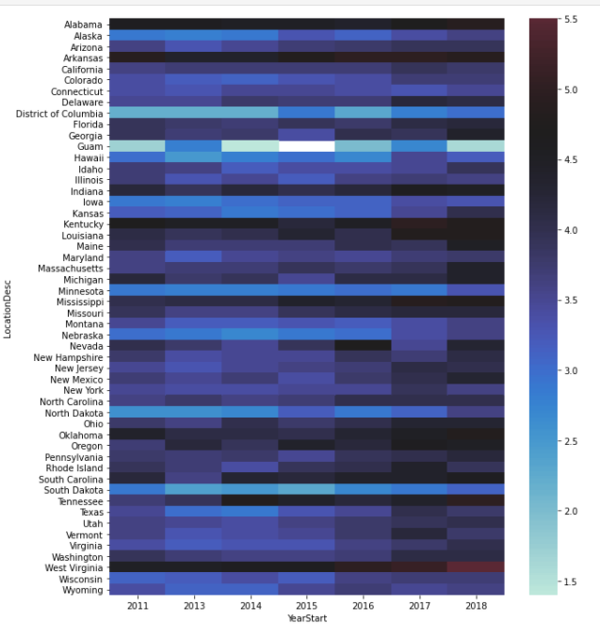
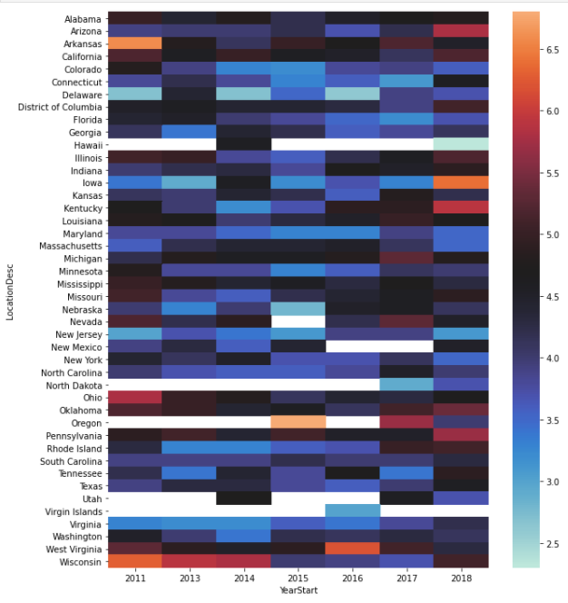
People of Color experienced 31.38% more unhealthy mental days per month in 2011. This gap decreased to 21.71% in 2018

Slide 13
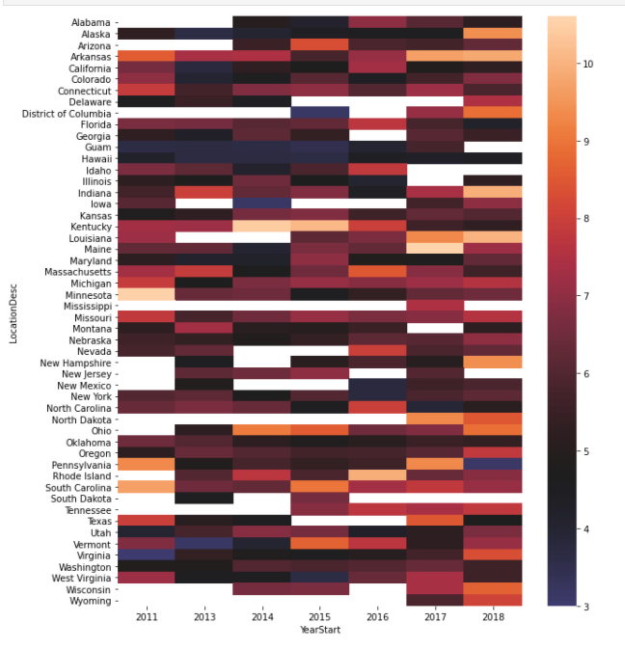
Multiracial population reported have 75.9% more unhealthy mental days per month than White population in 2011

Slide 14
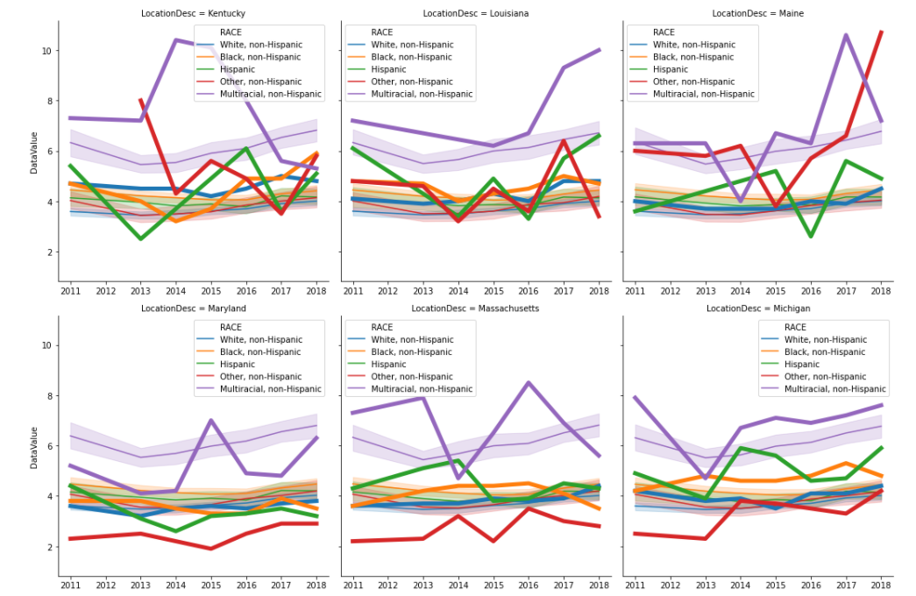
Heterogeneity In Experience Of Being A POC Across States

Slide 15
Part 3 Relation Between Mental Health and Well Being & Access to Care

Slide 16
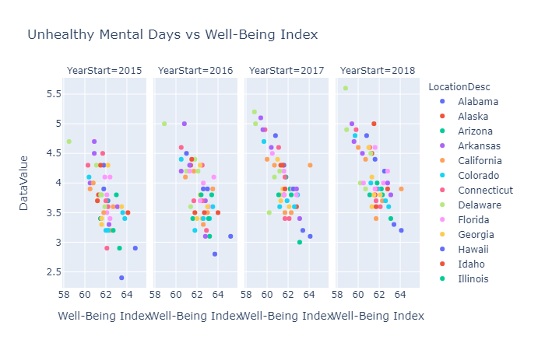
Strong Negative Correlation between Mentally Unhealthy Days and State Well -Being Index

Slide 17
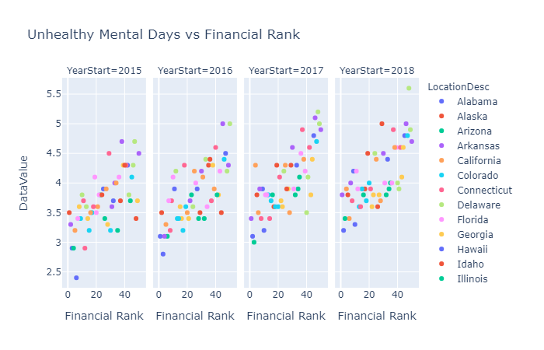
Strong Positive Correlation between Mentally Unhealthy Days and State Financial Rank

Slide 18
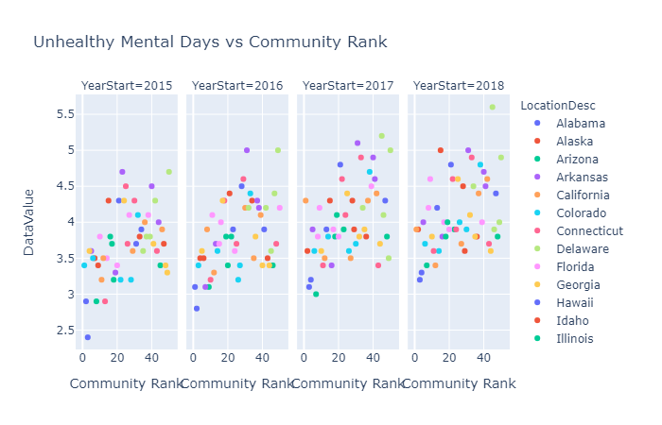
Positive Correlation between Mentally Unhealthy Days and State Community Rank

Slide 19
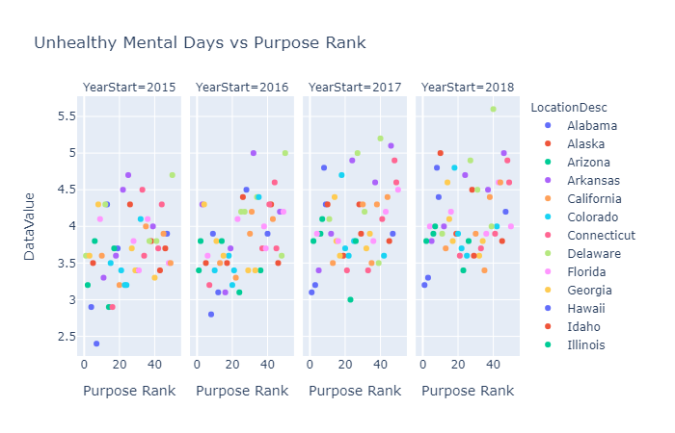
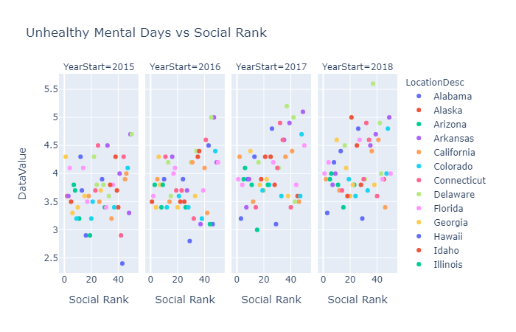
Almost No Correlation between Mentally Unhealthy Days and Social, Purpose and Physical Rank

Slide 20
States with Well Being index more than 61 on an average have less than 3.5 mentally unhealthy days and the ones with less than 61 have more than 4

Slide 21
States with Financial Rank more than 40 on an average have more than 4 mentally unhealthy days and the ones with less than 30 have less than 3.5 days

Slide 22
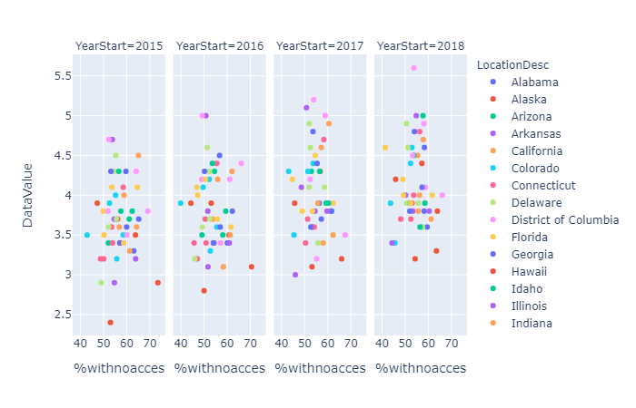
Almost No Correlation between Mentally Unhealthy Days and Access to Mental Health Care Access in State

Slide 23
03
CONCLUSION AND FUTURE SCOPE

Slide 24
Concluding Remarks
Never before has it been so timely and important to improve health care for people with mental and substance use disorders in the US.
The economic burden of these illnesses is tremendous. The estimated annual costs of in 2010 totaled $210.5 billion, including both direct costs and indirect costs such as mortality arising from depression-related suicides as well as the effects of depression in the workplace.
Improving mental health care is-and has been-a bipartisan issue. United States having a federal government structure affords individual states a unique opportunity to bridge the gap to quality care.
The report acknowledges that access to mental healthcare and any significant change for minority populations is a multipronged approach as no one reason can be attributed for any state performing poorly.
Notes:
The urgency of enhancing mental health care has been underscored by glaring social maladies, including homelessness, suicide among military personnel and veterans, incarceration, opiate addiction, and mass violence, which have galvanized public attention to mental illness.
The New Freedom Commission, convened by President George W. Bush in 2002, sounded a “clarion call for this and future administrations to pursue dramatic improvements in the mental health care delivery system.”5 However, “fragmentation, stigma, [and] frozen budgets” largely thwarted this effort. Since then, legislation such as the Mental Health Parity and Addiction Equity Act of 2008 (MHPAEA), as well as President Barack Obama’s health care reform bill, the Patient Protection and Affordable Care Act, have pushed forward expanded funding for mental health and substance use services. Yet previous efforts to address unmet public mental health needs have not succeeded in fulfilling their goals of broad access to quality care
That being said, the authors of this report advocate for alignment of financing systems with assessments of outcomes and internalising mental health equal importance to physical health and encouragement to reduce barriers and stigma for mental illness.

Slide 25
ALTERNATIVE RESOURCES
It is brave to ask for help.
For those of us without access to adequate healthcare or other constraints, please contact:
National Alliance for Mental Health helpline: 1-800-622- HELP
SAMSHA’s National Helpline: 1-800-950-NAMI
Mental Health America: 1-800-273-TALK

